Slide 1
Wireless Network Simulation For Modified AODV Protocol
Team Members
Group-D19
D. Mohammad Abdulla - BL.EN.U4AIE21044
G. Tejdeep Reddy - BL.EN.U4AIE21048
G. Mukesh Venkata Sai - BL.EN.U4AIE21050
S. Srihemanth - BL.EN.U4AIE21123

Slide 2
CONTENT
PROBLEM STATEMENT
WIRELESS TRACE FORMAT
AODV
MODIFYING THE EXISTING AODV PROTOCOL
CODE
RESULTS

Slide 3
PROBLEM STATEMENT
Implement the new routing protocol which modifies the existing AODV protocol. The change required is in the routing process:An extra information: Length of the packet – a value calculated by looking the number of bytes when a packet is received need to be used to route the packet. Larger sized packet has to be routed to best route and smaller sized packet has to be routed to next best route available. To verify the working of modified protocol, simulate a wireless network consisting of 6 mobile nodes (n0 –n5). Use the modified routing protocol.

Slide 4
AODV
The Ad hoc On-Demand Distance Vector (AODV) is a loop-free protocol that enables dynamic, self-starting, multihop routing between participating mobile nodes wishing to establish and maintain an ad hoc network.
It allows mobile nodes to obtain routes quickly for new destinations, and does not require nodes to maintain routes to destinations that are not in active communication.
It also allows mobile nodes to respond to link breakages and changes in network topology in a timely manner.
One distinguishing feature of AODV is its use of a destination sequence number for each route entry. Given the choice between two routes to a destination, a requesting node is required to select the one with the greatest sequence number.
Route Requests (RREQs), Route Replies (RREPs), and Route Errors (RERRs) are the message types defined by AODV. On receipt of the three AODV messages: RREQ, RREP and RERR, the nodes update the next hop, sequence number and the hop counts of their routes in such a way as to satisfy the constraint mentioned below.

Slide 5
At each node, AODV maintains a routing table. The routing table entry for a destination contains three essential fields: a next hop node, a sequence number and a hop count.
Suppose we have two nodes ‘a’ and ‘b’ such that ‘b’ is the next hop of ‘a’ to some destination ‘d’. Also, suppose the sequence number and hop count of the routes to ‘d’ at ‘a’ and ‘b’ are (seq_{a}, hct_{a}) and (seq_{b}, hct_{b}) respectively. Then the AODV protocol maintains the following property at all times:
(seq_{a} < seq_{b}) OR (seq_{a} = seq_{b} AND hct_{a} > hct_{b})
In other words, ‘b’ either has a newer route to ‘d’ than ‘a’, or ‘a’ has a shorter route that is equally recent. Under this constraint, the protocol is guaranteed to be free of routing loops.

Slide 6
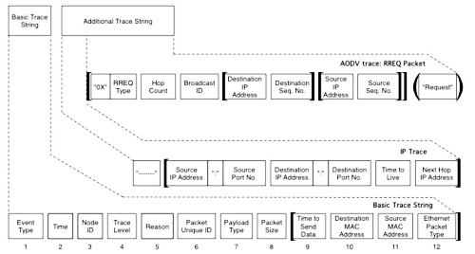
WIRELESS TRACE FORMAT

Slide 7
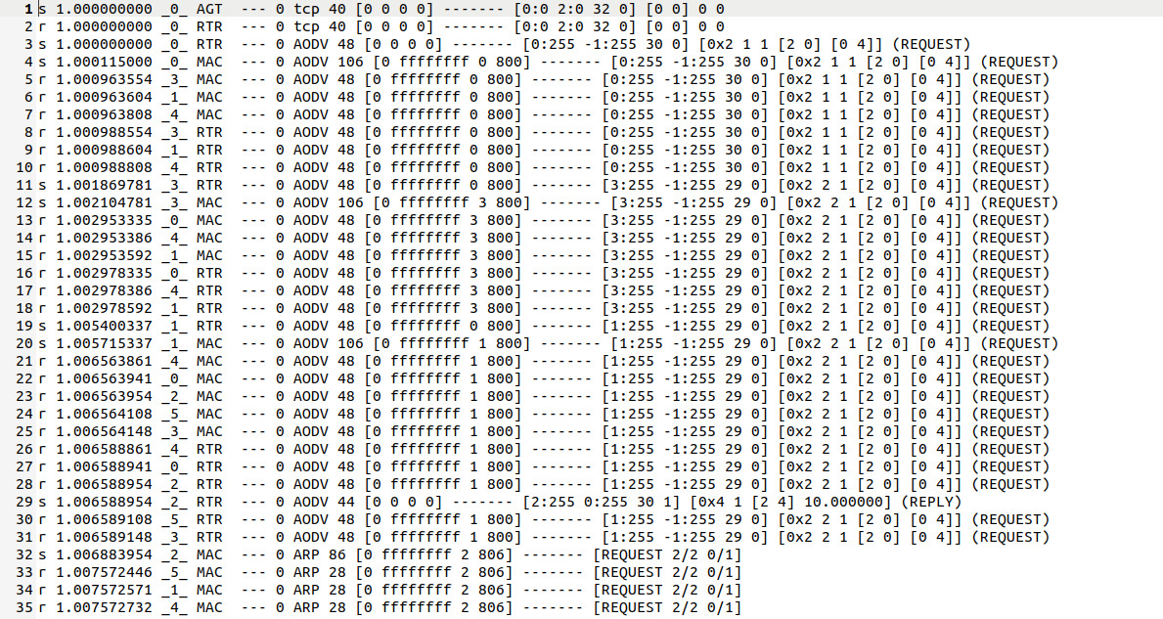
Example trace file

Slide 8
MODIFYING THE EXISTING AODV PROTOCOL
The following files of existing protocol are modified to add packet length
aodv_packet.h
aodv.h
aodv.cc
cmu-trace.cc

Slide 9
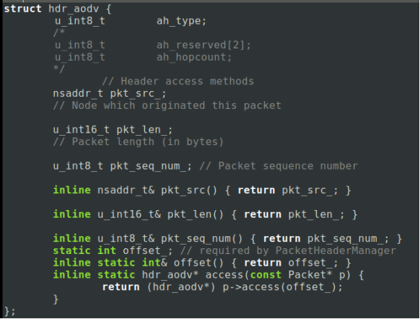
aodv_packet.h

Slide 10
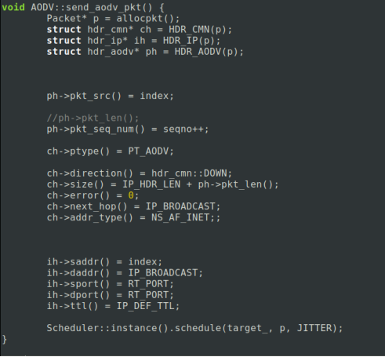
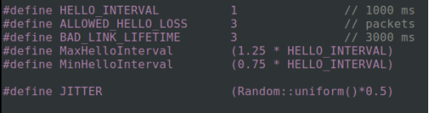
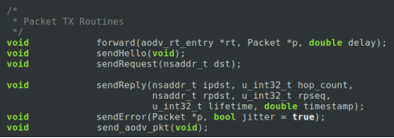
aodv.h aodv.cc

Slide 11
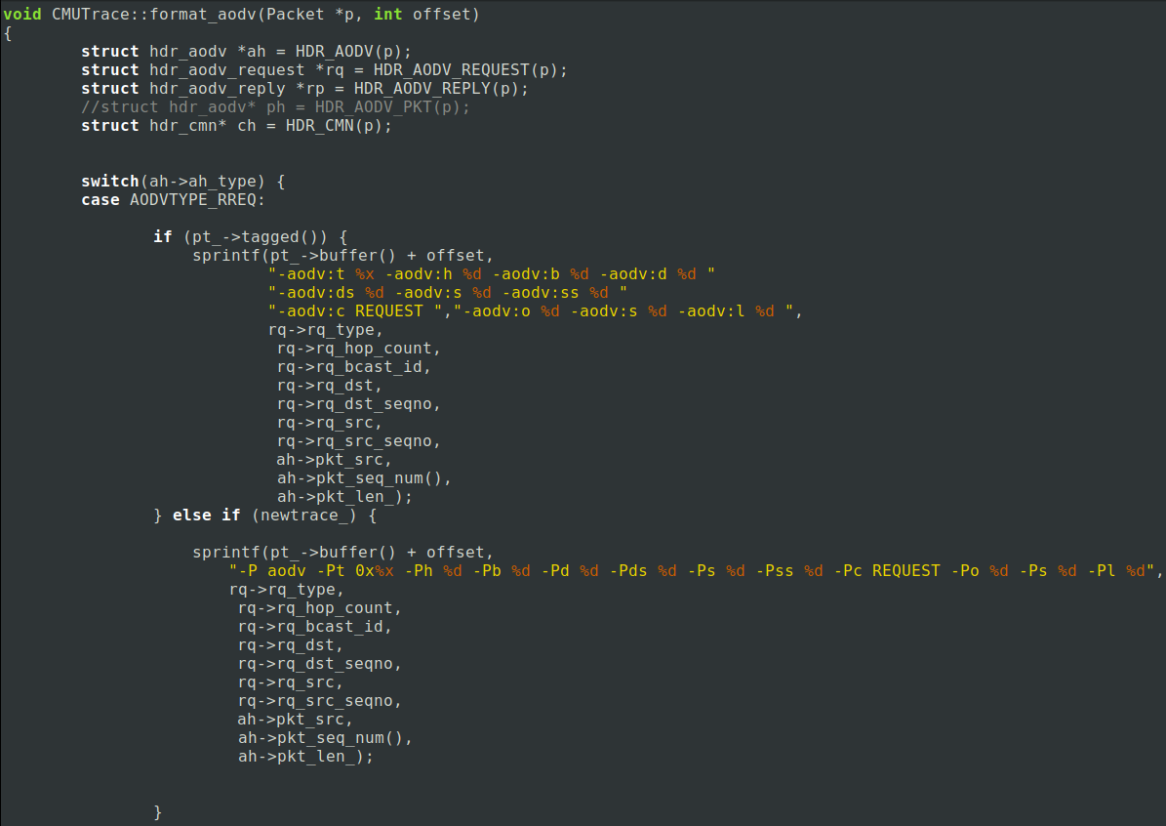
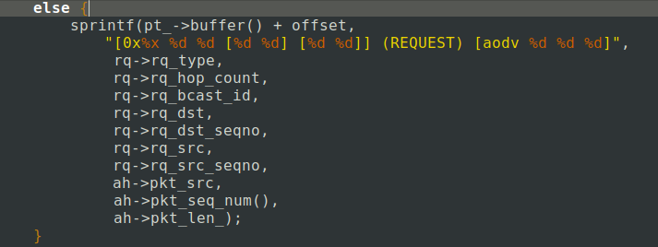
cmu-trace.cc

Slide 12
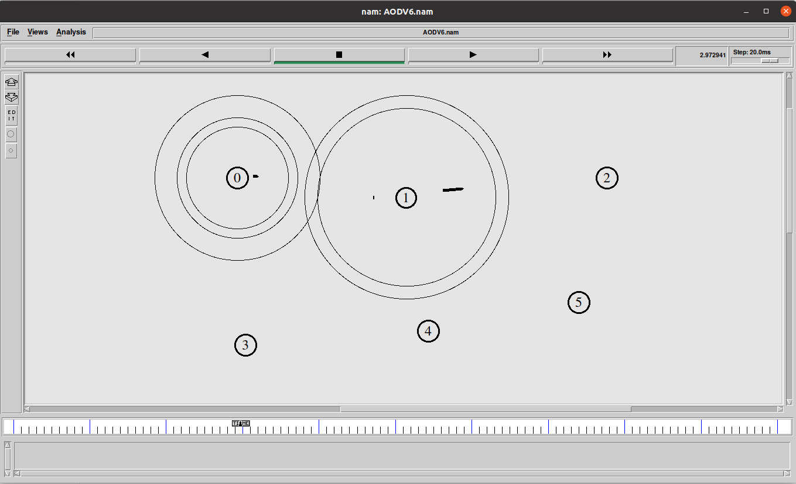
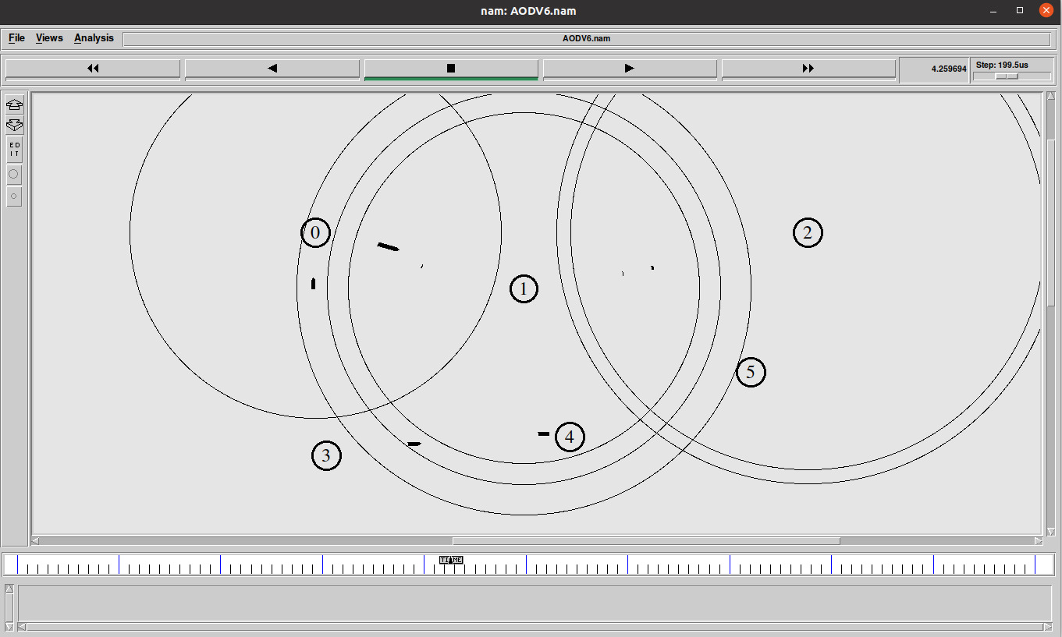
OUTPUT - NAM FILE

Slide 13
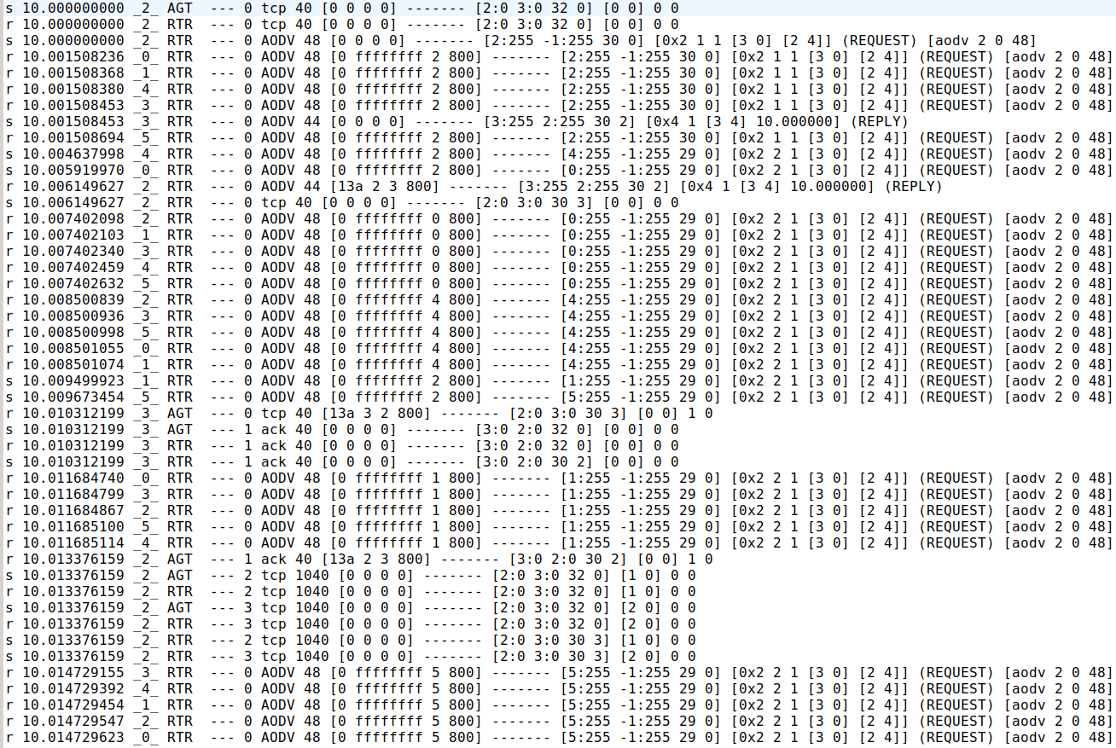
TRACE FILE

Slide 14
THANK YOU

